Slide 1
Introduction to Functions
Colorado State University
Computer Science Department
Slides Originally Created by Albert Lionelle (Albert.Lionelle@colostate.edu)

Slide 2
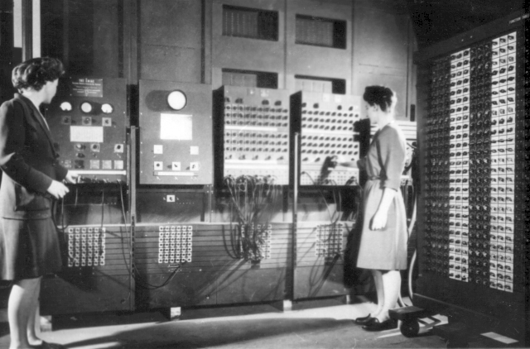
Reusable Code
Programming == Problem Solving
You look at the problem to solve
Clarify the problem and constraints
Break it up into *smaller* parts (Divide)
Outline the steps needed
Solve each step (Conquer)
Reassemble the pieces (Glue)
Completed program
The ENIAC women pioneered reusable code
But they also needed ways to modularize code
Over the years - Object Oriented Designed
Programmers Betty Jean Jennings (left) and Fran Bilas (right) operate ENIAC's main control panel By United States Army (Image from http://ftp.arl.army.mil/~mike/comphist/) [Public domain], via Wikimedia Commons
Divide
Conquer
Conquer
Conquer
Glue

Slide 3
Function Syntax Basics
int main(int argc, char **argv) {...}
int - return type
main - function name
int argc, char **argv - are parameters for the function
double getPercentGrowth(double startingSalary, double midCareerSalary) { …}
double - return type
getPercentGrowth - function name
double startingSalary, double midCareerSalary - are parameters for the function

Slide 4

Function Name & Parameters
They should have meaning!
They follow the same rules as variable names
No specials, start with letter, etc
Parameters are part of the name
getArea()
getArea(int x)
getArea(int x, int y)
Are three different functions! (Be careful)
The secret ninja trick for functions
Pass in the variables
Try to keep everything as contained as possible

Slide 5
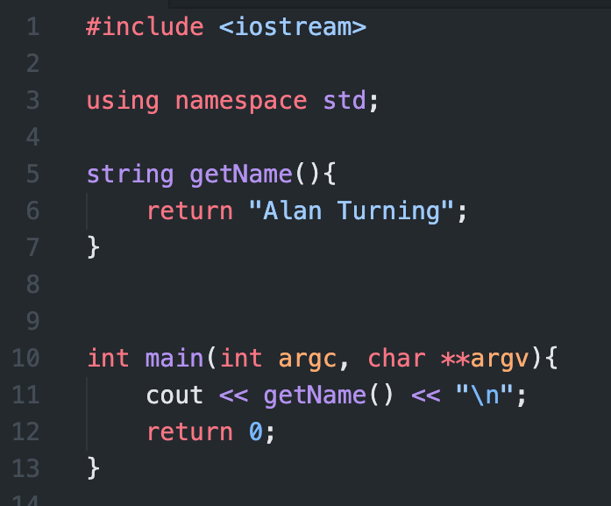
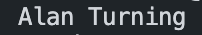
Return Type
Return Types
Critically important
Can return a primitive, array or an object
void is how you say the function returns nothing
Whenever you call a functions
Assume the return type is what is returned
Think of replacing the function name with the answer
The program output is
Notice: Alan Turning simply replaces ‘getName()’

Slide 6
Why Functions and Objects?

Slide 7
DRY Code
Fun Fact: Software Engineers, Andy Hunt and Dave Thomas, are credited with first using the the term for coding in the The Pragmatic Programmer
Code should be DRY
Don’t Repeat Yourself
Code should be
Reusable
Small Snippets
Reusable code
Only write once
Use in multiple applications
C++
Functions are blocks of reusable code
Ideally, no more than 20 instructions
Objects are blocks of information, with reusable code / functions
CLUE: If you are cutting and pasting code - it should be a function
Really, that happens
Divide
Conquer
Conquer
Conquer
Glue

